Slide 1
September 29, 2022
Quarterly Meeting

Slide 2
Welcome & Introductions
Thank you for joining us! Please share your name and what organization you are representing in the chat box.

Slide 3
LIHC Updates
LIHC Reset & Refresh
Convening partners
Engaging in primary and secondary data collection and analyses
Conducting consumer and provider-facing public information/awareness campaigns
Supporting adoption of policies related to healthier living
Promoting chronic disease self-care

Slide 4
LIHC Updates
Promoting Health & Wellness on Long Island
Long Island Health Collaborative (LIHC) established 2013
350 plus diverse partners, including all hospitals, two county health departments, community-based organizations, schools and colleges, local municipalities, health plans, physician groups, among others
Engage in primary and secondary data collection and analyses to assess the Long Island population’s health needs, barriers to care
Promote members’ chronic disease programs and self-care concept – nutrition and physical activity foundational principles

Slide 5
LIHC Updates
A Hub for Community Health
The hardest part of public health programming is making the community aware of what is available.
How do we help?
Collaborative Communications with updates, resources and community highlights
Public-facing community calendar
Internal networking channels to share data, information and more

Slide 6
LIHC Updates
CHNA Reports
State report due December 31, 2022
LIHC report templates available for each county
2 regional priorities agreed upon by consensus
Status check-in– questions?

Slide 7
Featured Presentation
New York State 1115 Medicaid Waiver
Featuring Kevin Krawiecki VP, Fiscal Policy, Economic, Finance, & Information Healthcare Association of New York State

Slide 8
1115 waiver amendment in context
2014
2023
Spur transformation activity: $8 billion
Advance health equity: $13.5 billion

Slide 9
Core features of the 1115 waiver amendment
Advance health equity via:
Regional planning and analytics (HEROs)
Development of CBO networks (SDHNs)
Use social care needs assessment, referral platforms, and data exchange
Medicaid payment for social interventions
% of waiver request
Single planning entity per region
2%
Single network leader per region
6%
DOH to develop assessment; systems used must meet interoperability criteria in order to qualify for use —
Accessible if doing VBP
50%

Slide 10
Core features of the 1115 waiver amendment
Advance health equity via: % of waiver request
System redesign funding 11%
Funding for transitional housing 12%
Workforce investments 11%
Digital and telehealth investments 2%
“In-reach” Medicaid services for incarcerated individuals 6%

Slide 11
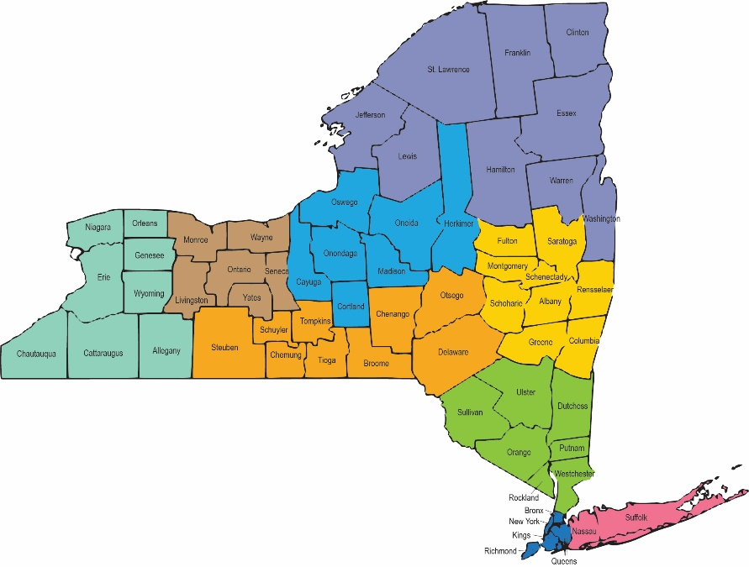
HERO Regions Proposed HERO regions
DOH proposed 9 HERO regions and notes undecided expansion of regions in final submission to CMS
Source: DOH provided map for proposed HERO regions as cited on page 10, DOH draft 1115 waiver amendment at: https://www.health.ny.gov/health_care/medicaid/redesign/2022/docs/2022-04_1115_waiver_draft_amendment.pdf.

Slide 12
Key dates
May 20, 2022: State public comment period ended
Sept. 2, 2022: DOH formal submission of amendment application to CMS
Oct. 19, 2022: Federal public comment period ends
Jan. 1, 2023: Proposed start date in application

Slide 13
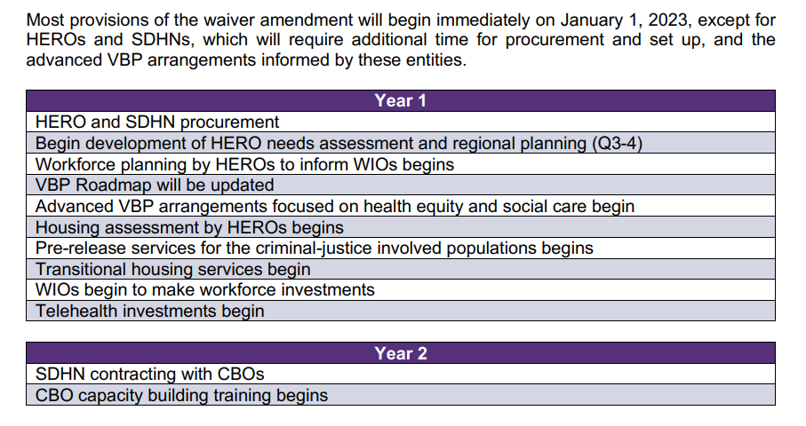
Suggested implementation timeline
Source: page 49-50 https://www.medicaid.gov/medicaid/section-1115-demonstrations/downloads/ny-medicaid-rdsgn-team-pa-09152022.pdf

Slide 14
LIHC Updates
LIHC Primary Research Data Highlights
Community Health Assessment Survey (CHAS)
CBO Survey Analysis
CBO Qualitative Analysis
Library Research Project Report

Slide 15
LIHC Updates
December 2022 Meeting Poll

Slide 16
LIHC Updates
Ongoing Engagement Opportunities
Bi-monthly Collaborative Communications
Talk with a Doc
Walk Safe with a Doc
American Heart Association island-wide programming (to come)

Slide 17
Moving Forward
Quarterly meetings to continue, registration links on LIHC website
Thursday, December 8, 2022
Next LIHC meeting: Thursday, December 8, 2022 9:30-11:30 AM

Slide 18
Discussion

Slide 19
Adjournment
Thank you!
www.lihealthcollab.org
(631) 963-4167 lihc@nshc.org

